Slide 1
Oh no.
George Ding

Slide 2
Real Data Analytics?
Let’s start off with my intuition. Revenue in websites would come from different Sources. If you have the user come to you through a google search, or through their ads, your revenue will take a huge hit, compared to the ones that had direct link sources, since you have to pay google themselves.
Therefore, lets separate these by their subsets:
Code:
googlesearch <- subset(P5_train1,P5_train1$Source == "GoogleSearch")
directlink <- subset(P5_train1,P5_train1$Source == "Directlink")
googlead <- subset(P5_train1,P5_train1$Source == "GoogleAdWord")

Slide 3
First Glance?
This data is actually real, and exploring through all data sets, I’ve realized there is no actual mathematical pattern in getting 100 percent accuracy for real logistic numbers. Therefore, we must use a linear model to draw a best fit line.
But then another question is there a straight fit line for just the entire data?
Let’s try it, just for fun!

Slide 4
Code:
lm <- lm(Revenue ~ Activity + Duration, data = googlead)
decision <- predict(lm, newdata = googlead)
mean((decision - googlead$Revenue)^2)
[1] 0.4912061
googlead$PREDICTED = 0
mean((googlead$PREDICTED - googlead$Revenue)^2) (Comparing if I just replaced it all with 0s)
[1] 0.515703 (Didn’t work lmao)
googlead$PREDICTED <- decision
googlead$PREDICTED[googlead$PREDICTED < .08] = 0 (Saw the lowest data that didn’t have a revenue of 0)
mean((googlead$PREDICTED - googlead$Revenue)^2)
[1] 0.4908223

Slide 5
Worked?
It seems that it worked for GoogleAdWord. But on a second look, GoogleAdWord has so many 0’s in revenue, this could just be an easy predictor data set.
Lets try on a higher and more complex data set: GoogleSearch, and DirectLink.

Slide 6
Code (GoogleSearch):
lm <- lm(Revenue~Duration + Activity + Source, data = P5_train1)
predict(lm, newdata = P5_train1)
decision <- predict(lm, newdata = P5_train1)
mean((decision - P5_train1$Revenue)^2)
[1] 49.55963
Analysis? Not great.

Slide 7
Code (DirectLink):
lm <- lm(Revenue~Duration+Activity,data = directlink)
a <- predict(lm,newdata = directlink)
mean((a - directlink$Revenue)^2)
[1] 153.0828
Analysis? Even worse.

Slide 8
Keep Exploring…
That’s when I realized something. Why not take individual data sets of each dataset (google search, direct links, google ad word), and break them down even further by activity?
Since each activity is a number, we can break them down with higher hopes of more concise prediction of each level of “activity”.
Code:
googles.1 <- subset(googlesearch, googlesearch$Activity == 1)
tree.googles.1 <- lm(Revenue ~ Duration, data = googles.1) <-(The reason I don’t include the other attributes is because I’m using Activity as a “level” on each different subset)
p <- predict(tree.googles.1, newdata = googles.1)
googles.1$PREDICTED <- p

Slide 9
Not done yet…
The predictor will give us a best fit line, and therefore will give us negative numbers. So. Lets implement this for accuracy:
Code:
googles.1$PREDICTED[googles.1$PREDICTED < 0] = 0
Wait, by doing that, why don’t we just graph this and see how it continues? Therefore, we can a higher accuracy by finding the lowest real Revenue and switching all those to 0s.
More Code:
plot(googles.1$Revenue,googles.1$PREDICTED)

Slide 10
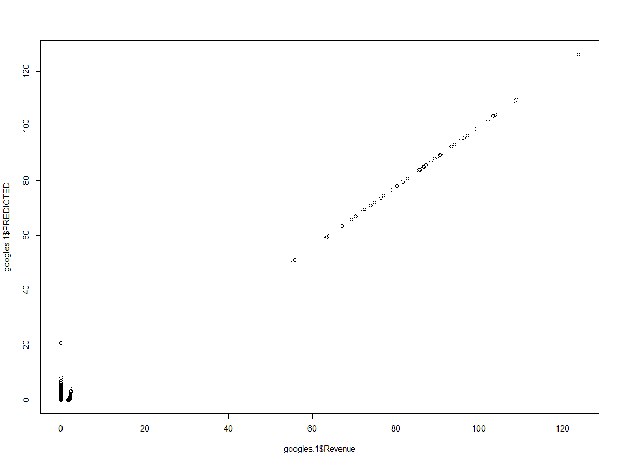

Slide 11
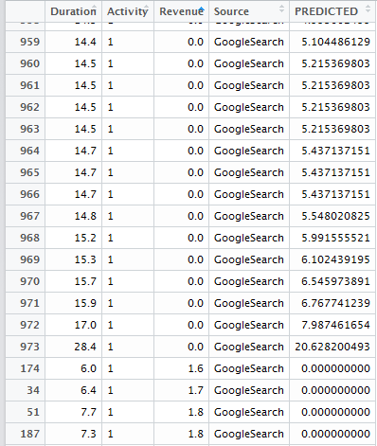
Graph Analysis
By analyzing this graph, we can see that there is still some predicted numbers that can still be zero.
Analyzing the actual data, the lowest number before hitting the high outlier is 8.
Therefore,
Code:
googles.1$PREDICTED[googles.1$PREDICTED < 8] = 0

Slide 12
Testing MSE on our first?
Code:
mean((googles.1$PREDICTED-googles.1$Revenue)^2)
[1] 0.8440999
Analysis? Much better.

Slide 13
But this doesn’t work with every graph
I only applied this to a certain amount of graphs, because as we remove the differences in these, the actual predictions with revenue > 0, and predicted < 8 , will now lose out on accuracy. I only do this to some graphs that have more numbers on predicted > (some number) such that it will give me a higher accuracy.
So, instead, lets rbind for googlesearch and see our analysis:
Code:
final.gs <- rbind(googles.1,googles.2,googles.3,googles.4,googles.5,googles.6,googles.7,googles.8,googles.9,googles.10,googles.11,googles.12,googles.13,googles.14,googles.15,googles.16,googles.17,googles.18,googles.19,googles.20,googles.21)
mean((final.gs$PREDICTED-final.gs$Revenue)^2)
[1] 0.8396814

Slide 14
And for DirectLink…
As I redone my entire process for DirectLink, I got a MSE of:
[1] 170.3976 (Higher than our earlier prediction model)
Thinking what I’ve done wrong, I’ve decided to return to the old code and to graph the plot for DirectLink:
Code:
plot(directlink$Revenue,directlink$PREDICTED)

Slide 15
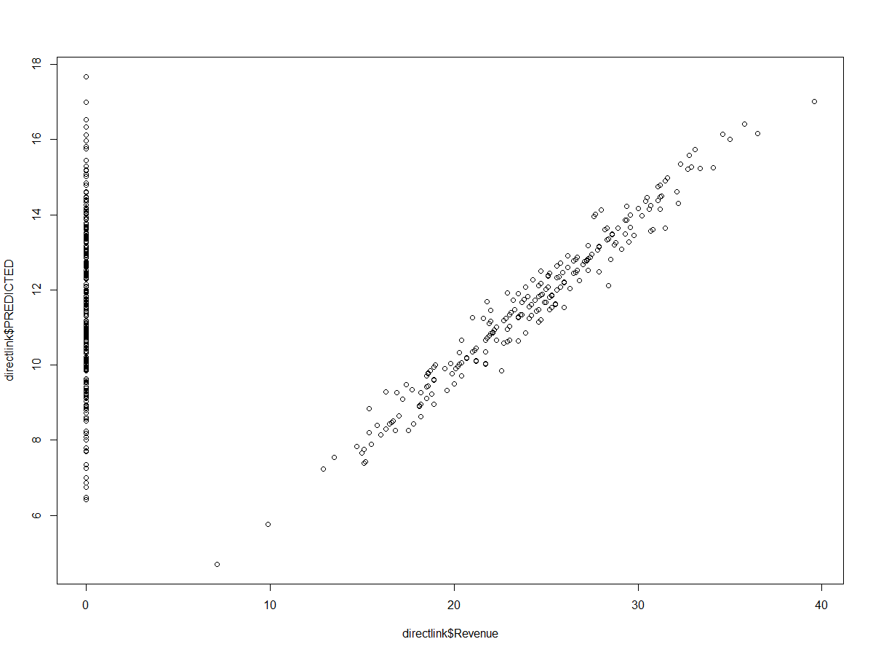

Slide 16
Analysis?
Seeing the amount of zero’s in revenue that got high numbers in the predicted model, I’ve realized that there was very little correlation in this model. We have data that’s like one man made a lot of money with a set of hours and activity, but then there could be many with more in both categories that would just make nothing.
Analysis? Just go with the simple linear model.

